Slide 1

Towards Machine Learning Based
IoT intrusion Detection Service
TagyAldeen Mohamed
Takayuki Ito Laboratory,
Nagoya Institute of Technology, Japan
tagy.mohamed@itolab.nitech.ac.jp
27-6-2018
IEA-AIE 2018
Notes:
Introduce your self

Slide 2
1
Motivation
CONTENTS
2
Steps and methods
3
DataSet used
4
Techniques & Model
5
Discussion and Conclusion
Notes:
Very quickly

Slide 3
Motivation
Traditional security Solutions
IoT traditional network security solutions may not be directly applicable due to the differences in IoT structure and behavior.
Low operating energy
IoT
Low operating energy and minimal computational capabilities.
Therefore security mechanism such as encryption protocols and authentication can not be directly applied.
IoT architecture
The lack of a single standard for IoT architecture.
IoT may have different policies, and connectivity domains.
Notes:
IoT is everywhere now.
Stuxnet worm & Iran's nuclear program.
More data is produced by people now days.
A case of finding anomalies that could threaten privacy, data security.
UNSW-NB15 Dataset.

Slide 4
UNSW-NB15 Data set
Splitting for Trainging & Testing
Data can’t be split to have for example 10 % for testing and 90 % per for training per category, because the categories would still be very unbalanced.
Normal
90%
Solutions !!
Under sample the data by selecting much smaller sets of data per category.
52%
Attack
10%
Category data portions
Notes:
IXIA PerfectStorm tool in the Cyber Range Lab of the Australian Centre for Cyber Security
1- The category data is very unbalanced with normal network data having the major portion (about 90 %).
2- Some attack categories have very little data points.
3- Data can’t be split to have for example 10 % for testing and 90 % per for training per category, because the categories would still be very unbalanced.
4- The solution is to undersample the data by selecting much smaller sets
of data per category, by removing some of the majority class so it has less effect on the algorithm
ExtraTreexClassifier was used to get most important features.
Normal 2 218 761
Fuzzers 24 246
Analysis 2 677
Backdoors 2 329
DoS 16 353
Exploits 44 525
Generic 215 481
Reconnaissance 13 987
Shellcode 1 511
Worms 174

Slide 5
Steps & Methods
Data Preprocessing
ExtraTrees Classifier
CSV processed with:
1-Pandas, Numpy, h5py
2-remove NaN`s..
3-A lot of features.
4-features importance.
Attack or not Classification
1
2
3
4
Newural Network
Trees result + Testing Data to Categorize attacks
Final Predictions
To which category attack is belong
Notes:
1- H5py used to store the data between steps
2- Numpy for Nans
3- TimeStamp features was moved because they cant be used in feed forward neural network, Designing RNN is out of scope for this work.
4- Nominal data was vectorized by one-hot encoding. 294 feature .

Slide 6
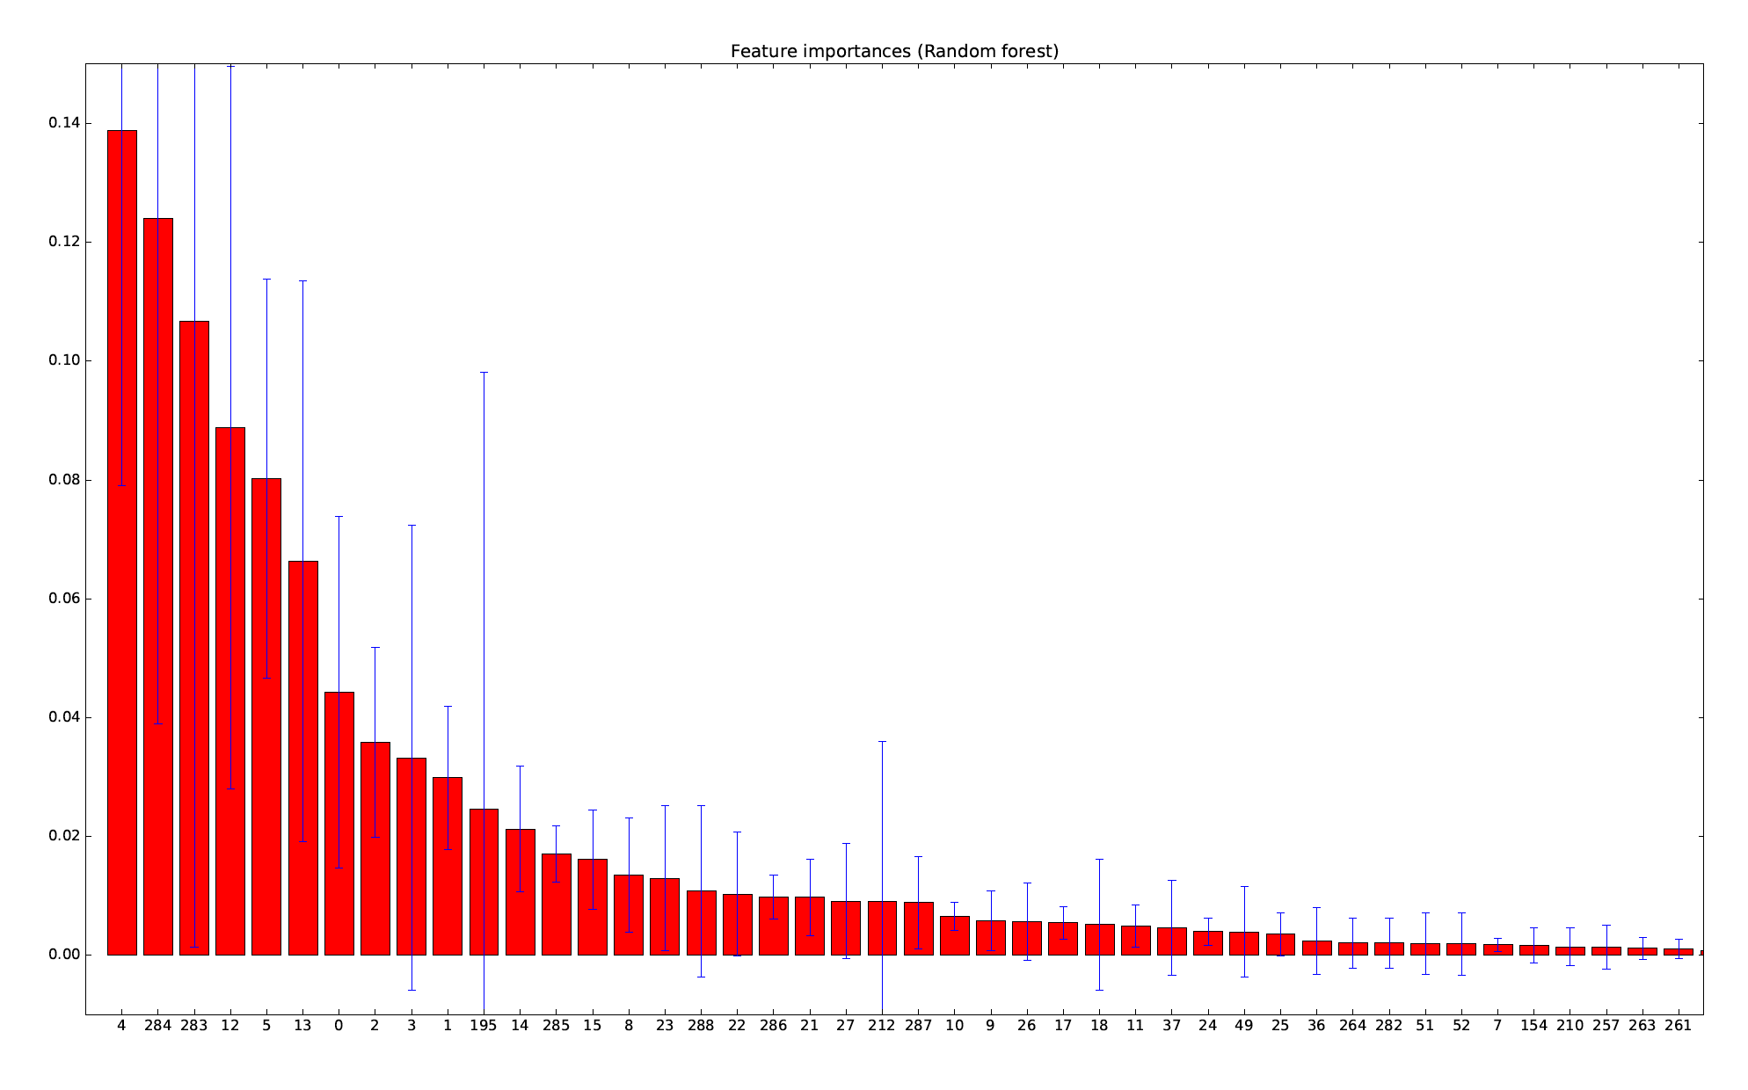
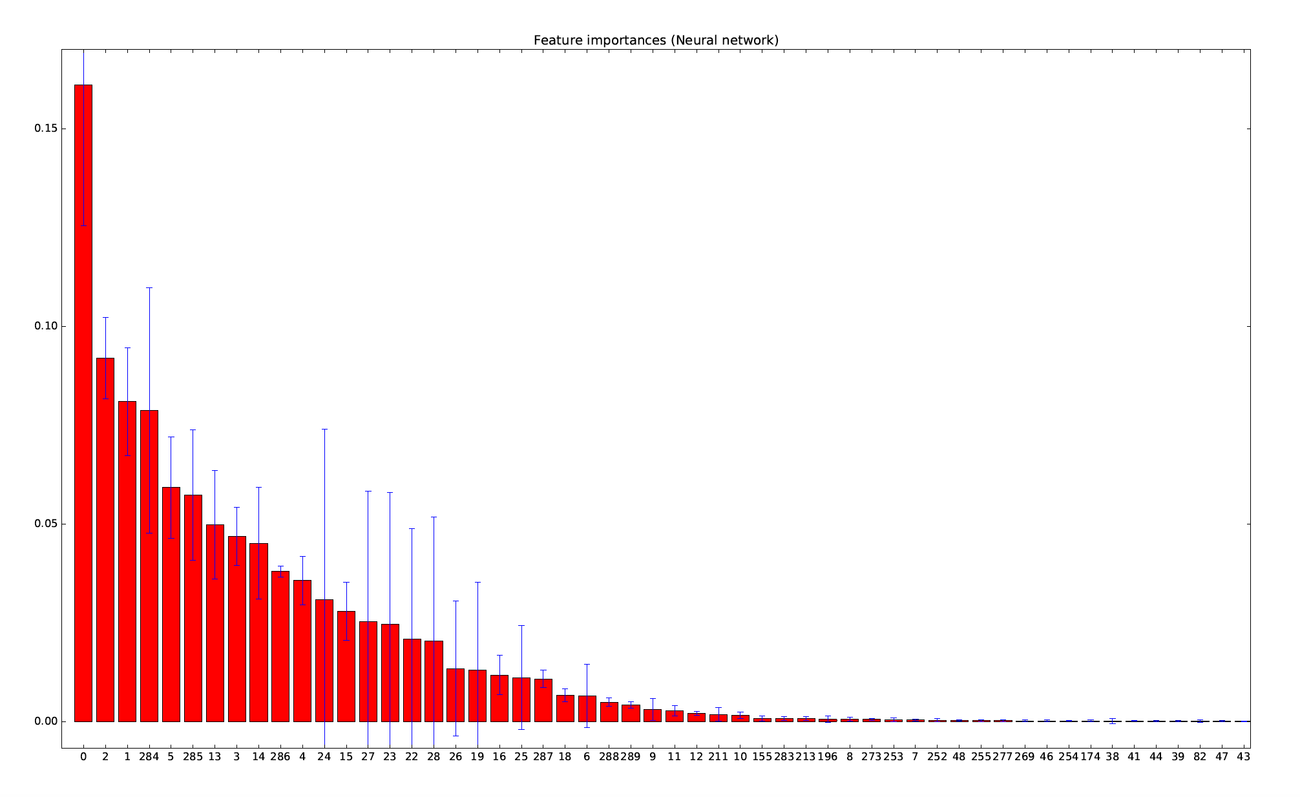
Features importance
Features importance for ”attack or not” (random forest) classifier.
Features importance for category (neural network) classifier.
X axis values are feature indices
Notes:
Top 10 features for attack or not.
Top 25 for categorization.
building random trees over entire feature space might be wasteful.
For random forest
4 dsport integer Destination port number
12 sloss Integer Source packets retransmitted or dropped
5 proto nominal Transaction protocol
13 dloss and sloss Integer Destination and source packets retransmitted or dropped
14 service nominal http, ftp, smtp, ssh, dns, ftp-data ,irc and (-) if not much used service
For neural network
2 sport integer Source port number
1 srcip nominal Source IP address
14 service nominal http, ftp, smtp, ssh, dns, ftp-data ,irc and (-) if not much used service

Slide 7
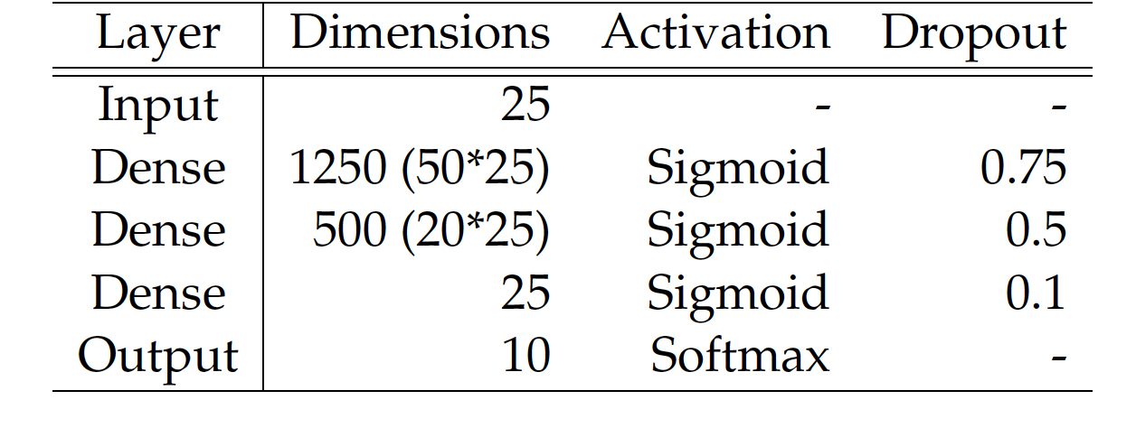
Overall architecture
Testing Data
ExtraTrees
Attack or Not
Testing Data
Neural Network
Category prediction
Notes:
The results suggest that the ExtraTreesClassifiers works very well with this data.
The scores improved even more after feature reduction with the same classifier.

Slide 8
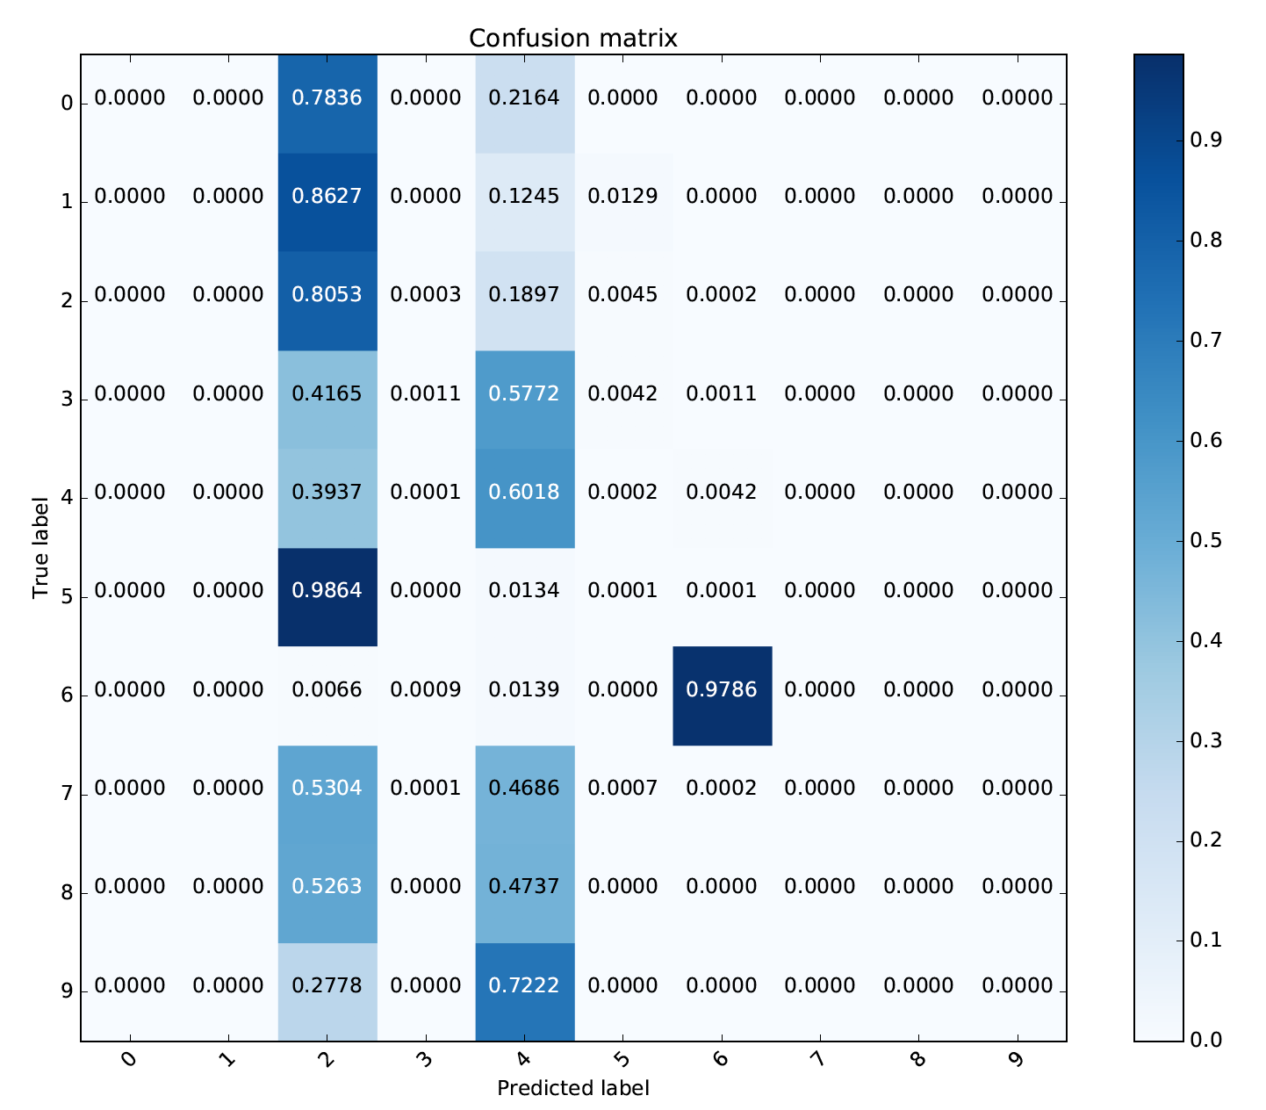
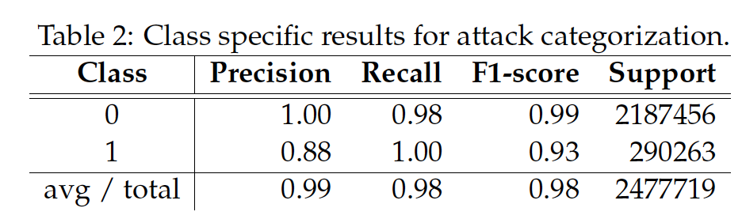
Discussion
Over all accuracy is 87%
Confusion matrix for attack categorization.
Notes:
Is the model good enough ?
The results suggest that the ExtraTreesClassifiers works very well with this data.
we could risk removing some of the majority class instances which is more representative,
For sampling Synthetic Minority Over-Sampling Technique) was introduced that try to address the class imbalance problem. It is one of the most adopted approaches due to its simplicity and effectiveness.
The results suggest that the neural network has learnt to classify samples
mostly to the classes 2, 4 and 6.

Slide 9
https://github.com/TGyAlDeen
We Are Done ☺
Thank you
Any advices !
Source Code and slides are available
tagy-aldeen@hotmail.com
PPT模板下载：www.1ppt.com/moban/ 行业PPT模板：www.1ppt.com/hangye/
节日PPT模板：www.1ppt.com/jieri/ PPT素材下载：www.1ppt.com/sucai/
PPT背景图片：www.1ppt.com/beijing/ PPT图表下载：www.1ppt.com/tubiao/
优秀PPT下载：www.1ppt.com/xiazai/ PPT教程： www.1ppt.com/powerpoint/
Word教程： www.1ppt.com/word/ Excel教程：www.1ppt.com/excel/
资料下载：www.1ppt.com/ziliao/ PPT课件下载：www.1ppt.com/kejian/
范文下载：www.1ppt.com/fanwen/ 试卷下载：www.1ppt.com/shiti/
教案下载：www.1ppt.com/jiaoan/
字体下载：www.1ppt.com/ziti/

